Slide 1
Maternal Substance Use Disorder: Addressing Fear and Discrimination (Part I)
Sharon Morello RN, BSN

Slide 2
Opioid Epidemic and Substance Use Disorders

Slide 3
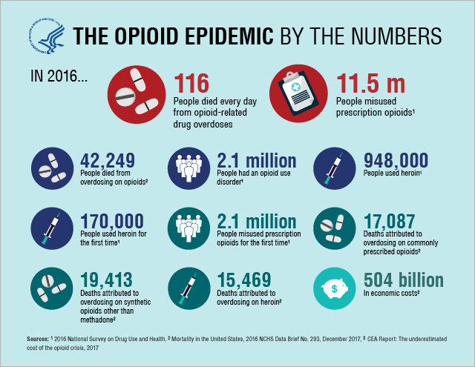

Slide 4
Heroin use climbed then stabilized
See table 7.2 in the 2017 NSDUH detailed tables for additional information and the 2017 CDC Mortality Data.
PAST YEAR, 2002 AND 2015-2017, 12

Slide 5
Substance Use Among Pregnant Women
Special analysis of the 2017 NSDUH Report.

Slide 6
Sources Where Pain Relievers Were Obtained for Most Recent Misuse Among People Who Misused Prescription Pain Relievers
See figure 26 in the 2017 NSDUH Report for additional information.

Slide 7
Where Do We Need
to Go From Here? TODAY!
We have the science
WE need to Advance the knowledge
and…
and…
Erase the STIGMA
Erase the STIGMA
Notes:
Our top priorities remain: to advance the science through research and erase the stigma through education. Through sponsoring pivotal research and working with others, NIDA is bringing new insights into the mechanisms of addiction to communities around the country, helping to reduce associated stigma and suffering.

Slide 8
What is already known on this topic?
The rate for drug overdose deaths has increased approximately 140% since 2000, driven largely by opioid overdose deaths.
After increasing since the 1990s, deaths involving the most commonly prescribed opioid pain relievers (i.e., natural and semisynthetic opioids) declined slightly in 2012 and remained steady in 2013, showing some signs of progress.
Heroin overdose deaths have been sharply increasing since 2010.

Slide 9
23.5 Million Americans currently have an Addiction
Only 10% in treatment
23 Million in people in recovery

Slide 11
As Healthcare workers we need to be leaders in changing the tide of this epidemic by:
Decreasing stigma
Increase access to evidence-based care, including Medication Assisted treatment
Supporting expanded use of naloxone
Recognize and provide screening, brief intervention and referral to treatment (SBIRT)

Slide 12
Reducing Stigma among our profession and in community
Know the facts
Beware of your own attitudes and behaviors
Choose words carefully
Educate others
Focus on the positive

Slide 13
The Science of Addiction
There is a growing body of evidence of structural vulnerability of brains to the effects of intoxicating substances
Several factors contribute to this Vulnerability:
Genetics
Early developmental influences and environmental factors
Effects of stressful life events across the life cycle
Mental disorders-principally depression and anxiety

Slide 14
Who is Vulnerable?
Persons most at risk for substance abuse and more so dependence, generally have higher rates of impulsivity, more difficulty managing negative affects-their moods and feelings
The drug dependent person, even before ever using drugs, has brain characteristics that may predispose a vulnerability to the effects of mind-altering drugs.
After a long period of using drugs, the addicted person ends up with a substantial altered brain-chemically and even anatomically
Some people are born with “imbalances” of certain nuerotransmitters such as serotonin

Slide 15
Brain functioning under other insults-similarity to addiction
The long-term effects of substance use and even long-term untreated depression can reduce frontal lobe functioning in the human brain
The frontal lobes are where planning, executive functions, emotion management, and reasoning occurs- AND this is the area of that brain most needed for recovery activities
In addition, head injuries can produce similar effects on the frontal lobes.

Slide 16
Reward Center Reward Center Natural rewards Food Sex Excitement Comfort

Slide 17
The bottom line from the scientific point of view
Just say “no” is unrealistic
It would be comparable to telling someone with diabetes, to just ”get over it”
Treatment may be need and may include medications to help the brain re-establish its equilibrium
In fact, some people will need long term medications to offset genetic neurochemical problems or to help the brain to compensate for the lost substance.
Some will need newer generation of anti-craving medications or replacement medications such as buprenorphine or Methadone
Science suggests that the idea of “moral deficiency” is inappropriate and stigmatizing

Slide 18
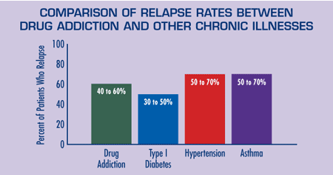

Slide 19
State DATA
Emergency Room Visits
Deaths
ER visits in August 2019= 162
Total for this year January to August =1,086
From January to June =156
July to October=52
(DATA not complete for these months)

Slide 20
Numbers in Rhode Island =11,498
Number of patients prescribed methadone for Opioid Use Disorder=5,921
Number of patients prescribed buprenorphine/naloxone for Opioid Use Disorder=5,419
Number of patients on Vivitrol for Opioid Use Disorder =158

Slide 21
Rationale for Opioid Use Disorder Treatment
Medications prescribed for opioid use disorder
Methadone
Buprenorphine
Why and how the body responds
Stabilize neuronal circuitry
Mu occupation/blockade
Cross-tolerant, long acting, oral
Prevent withdraw and craving
Extinguish compulsive behavior
Prevent spread of HIV and HCV
Prevent criminal activity

Slide 22
MYTH There isn’t any proof that MAT is the gold standard
FACT:
MAT is evidence-based (Many, many clinical trials since 1970’s -2000’s) and is the recommended course of treatment for OUDs. The National Institute of Dug Abuse, Substance Abuse Mental Health Services Administration, National Institute on Alcohol Abuse and Alcoholism, Center for Disease Control and Prevention and other agencies emphasize MAT as the first line of treatment

Slide 23
MYTH Medication-Assisted Treatment substitutes one drug for another
FACT:
When properly prescribed, medications reduce drug cravings and prevent relapse without causing a “high.”
Methadone and buprenorphine are opioid-based and result in physical dependence, but are fundamentally different from short-acting opioids such as heroin and prescription painkillers. The latter go right to the brain causing sedation and euphoria (a “high”). In contrast, MAT medications help patients disengage from drug seeking and related criminal behavior and become more receptive to behavioral treatments. Injectable naltrexone is not opioid based and does not result in physical dependence.

Slide 24
MYTH Addiction medications are a “crutch” that prevents “true recovery.”
FACT:
Individuals stabilized on MAT can achieve “true recovery,” according to leading addiction professionals and researchers. This is because such individuals do not use illicit drugs, do not experience euphoria, sedation, or other functional impairments, and do not meet diagnostic criteria for addiction, such as loss of volitional control over drug use. MAT consists not only of medication but also of behavioral interventions like counseling. The medication normalizes brain chemistry so individuals can focus on counseling and participate in behavioral interventions necessary to enter and sustain recovery.

Slide 25
MYTH MAT should not be long term.
FACT:
There is no one-size-fits-all duration for MAT. The Substance Abuse and Mental Health Services Administration (“SAMHSA”) recommends a “phased approach,” beginning with stabilization (withdrawal management, assessment, medication induction, and psychosocial counseling), and moving to a middle phase that emphasizes medication maintenance and deeper work in counseling. The third phase is “ongoing rehabilitation,” when the patient and provider can choose to taper off medication or pursue longer term maintenance, depending on the patient’s needs. For some patients, MAT could be indefinite.8 The National Institute on Drug Abuse (“NIDA”) describes addiction medications as an “essential component of an ongoing treatment plan” to enable individuals to “take control of their health and their lives.” For methadone maintenance, NIDA states that “12 months of treatment is the minimum.”

Slide 26
Benefits of Pharmacotherapy for Pregnant Women With OUD
Pharmacotherapy is a critical element in the treatment of OUD for pregnant women.
Pharmacotherapy helps patients with OUD avoid
Experiencing withdrawal symptoms.
Overwhelming cravings when the opioid misuse is stopped.
Pharmacotherapy can help pregnant women stop
Injecting drugs, a primary route of infection for people who use drugs.
Risky behaviors associated with drug acquisition.

Slide 27
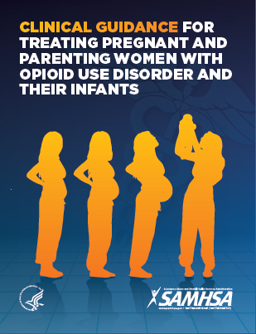
Overarching Recommendations
Buprenorphine and methadone are the safest medications for managing OUD during pregnancy
Medically supervised withdrawal is not recommended during pregnancy
Transitioning from methadone to buprenorphine or from buprenorphine to methadone is not recommended
Breastfeeding is recommended for women on buprenorphine and methadone
NAS should not be treated with dilute tincture of opium
https://store.samhsa.gov/product/SMA18-5054

