Slide 1


Developmental Outcomes of
Children with Prenatal Opioid Exposure
Barry M. Lester, Ph.D.
Professor of Psychiatry and Pediatrics
Director, Brown Center for the Study of Children at
Risk, Center for Children and Families
Alpert Medical School of Brown University
Women and Infants Hospital
Rhode Island Department of Health Conference to Support Pregnant and
Parenting Families Impacted by Substance Use Disorders
November, 2019

Slide 2

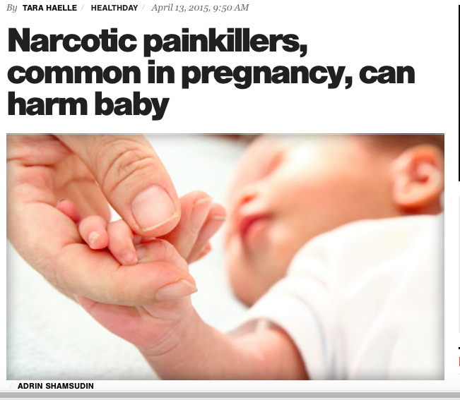
Opioid Use Disorders: GENTRIFIED
A public health concern of epidemic proportion
Crosses cultural, socioeconomic, and gender barriers affecting everyone without prejudice, including infants

Slide 3
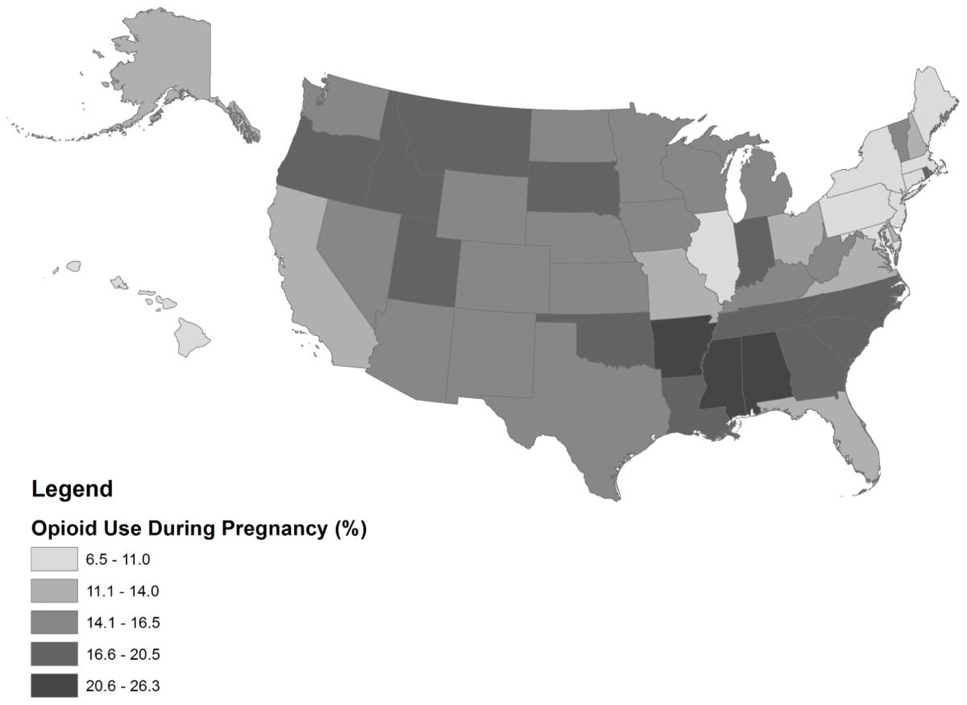
Pregnancy and Prescription Opioids
  Nationally 14% of all pregnant women receive an opioid prescription*
(Bateman et al, Anesthesiol. 2014)

Slide 4
Opioids and Developmental Outcome
Relative to other substances (cocaine, marijuana, tobacco, alcohol) literature on long term effects of prenatal opiate (heroin and methadone) exposure is relatively sparse

Slide 5
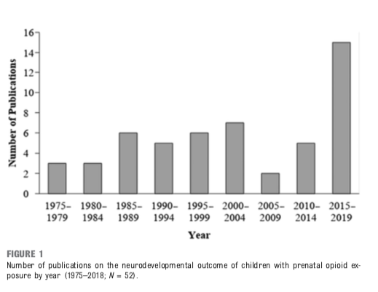
Opioids and Developmental Outcome
Conradt E, Flannery T, Aschner JL, et al. Prenatal Opioid Exposure: Neurodevelopmental Consequences and Future Research Priorities. Pediatrics. 2019;144(3):e20190128

Slide 6
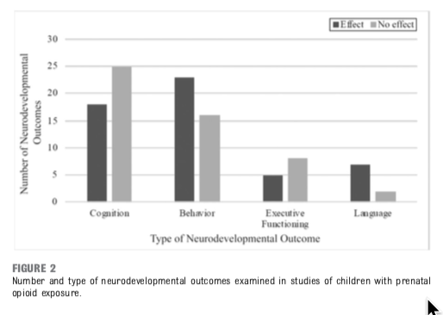
Opioids and Developmental Outcome
Conradt E, Flannery T, Aschner JL, et al. Prenatal Opioid Exposure: Neurodevelopmental Consequences and Future Research Priorities. Pediatrics. 2019;144(3):e20190128

Slide 7
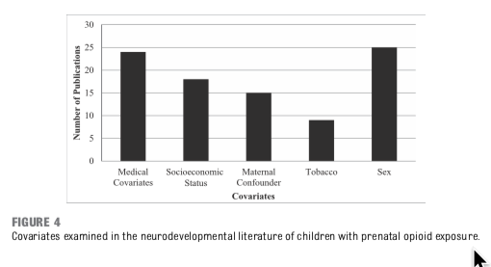
Opioids and Developmental Outcome
Conradt E, Flannery T, Aschner JL, et al. Prenatal Opioid Exposure: Neurodevelopmental Consequences and Future Research Priorities. Pediatrics. 2019;144(3):e20190128

Slide 8
Opioids and Developmental Outcome
Conclusions that can be drawn regarding the neurodevelopmental outcomes of prenatal opioid exposure are limited because of a number of key methodologic shortcomings in the literature
Small sample sizes makes it difficult to adjust for confounding variables
Important potential confounding variables include prenatal exposure to substances other than opioids, nutrition during pregnancy, inadequate prenatal care, medical complications, socioeconomic status, the quality of the child-rearing environment, maternal mental health, maternal trauma exposure, and partner use of substances.

Slide 9
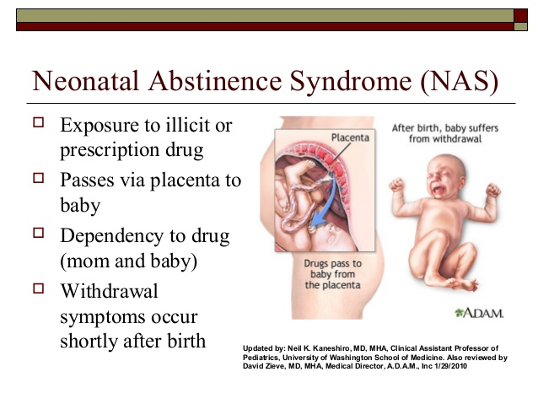
Notes:
MC

Slide 10
Neonatal Abstinence Syndrome (NAS)
Array of signs and neurobehaviors in the newborn that occur after discontinuation of prenatal exposure to substances taken by the mother.
Used to describe neonatal symptoms occurring after in-utero exposure to opioids such as heroin, methadone, and buprenorphine and use or misuse of prescription opioid containing medications such as hydrocodone (e.g., Vicodin) or oxycodone (e.g., Oxycontin).
Start pharmacological treatment

Slide 11
Neonatal Abstinence Syndrome (NAS)
Specific Symptoms
  excessive high-pitched cry/irritability
  sleep–wake disturbances
  alterations in infant tone (hypertonicity), movement, hyperactivity, abnormal reflexes, tremors and skin excoriations
  feeding difficulties
  gastrointestinal disturbances (vomiting and loose stools)
  autonomic dysfunction (sweating, sneezing, fever, nasal stuffiness, and yawning)

Slide 12
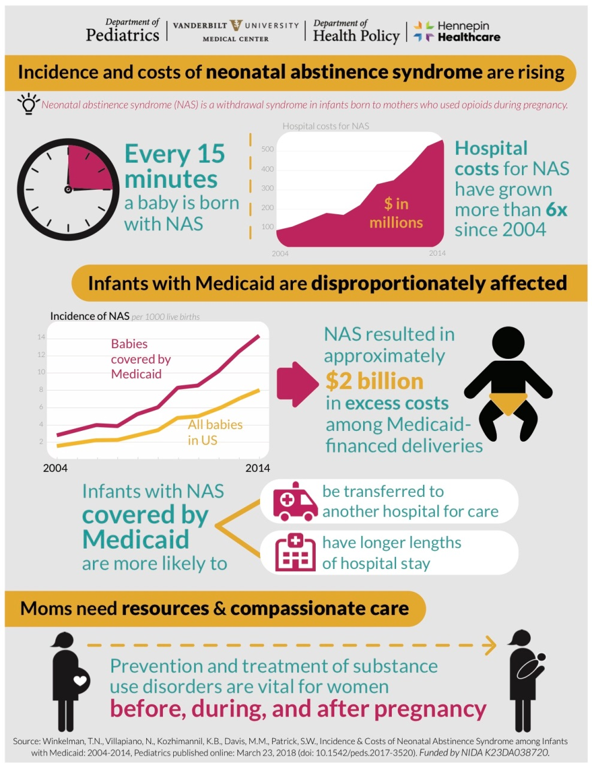
Neonatal Abstinence Syndrome (NAS)

Slide 13
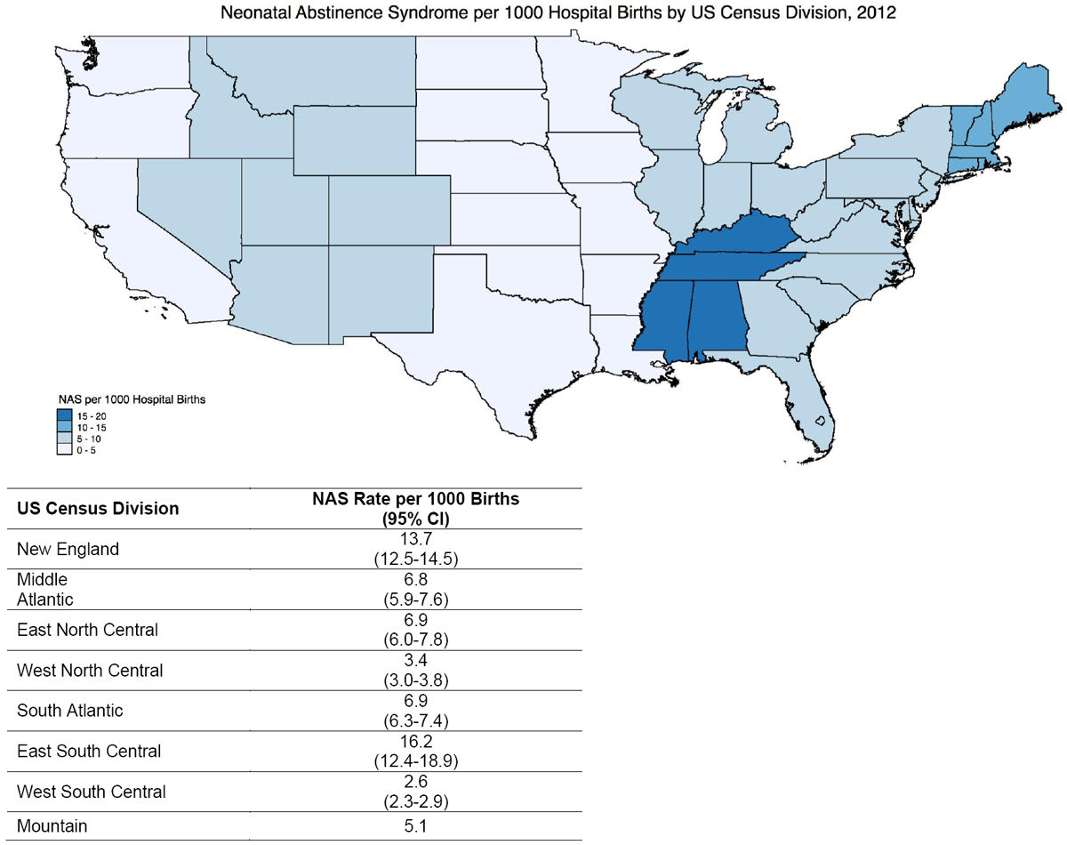
Incidence of Neonatal Abstinence Syndrome (NAS)
2
1

Slide 14
NAS Statistics in Rhode Island
NAS rates in RI have more than doubled in the last decade
  2005 4.4 / 1000 births
  2010 5.6 / 1000 births
  2015 9.5 / 1000 births
  2017 15 / 1000 births
2015 97% of NAS Births were at Women & Infants
98% were managed in the Mother Baby Unit

Slide 15
Neonatal Abstinence Syndrome (NAS)
Other substances produce neurobehavioral dysregulation in the neonate and NAS “like” symptoms
They can also potentiate the infant’s expression of opioid-induced NAS:
  alcohol
  cocaine
  methamphetamine
  nicotine
  psychiatric medications (antidepressants-SRIs)
  marijuana
Neonatal Opioid Withdrawal Syndrome (NOWS)
  Clarify syndrome is specific to opioids

Slide 16
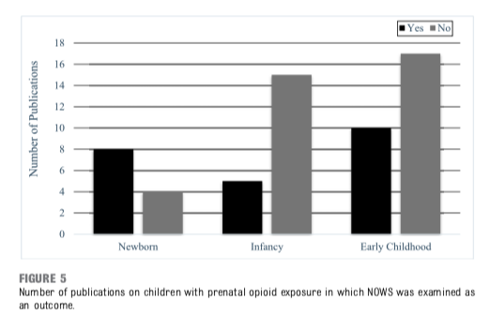
Opioids and Developmental Outcome
Conradt E, Flannery T, Aschner JL, et al. Prenatal Opioid Exposure: Neurodevelopmental Consequences and Future Research Priorities. Pediatrics. 2019;144(3):e20190128

Slide 17
Neonatal Abstinence Syndrome (NAS)
Polysubstance use/abuse is the norm
Additional risks for these women:
  psychiatric co-morbidities
  exposure to violence
  lack of prenatal care
  poor nutrition
  stress
  genetic
  epigenetic
How the substance-exposed neonate presents could be
due to a combination of these and other factors rather than to one specific drug, factors that could potentiate opioid effects.

Slide 18

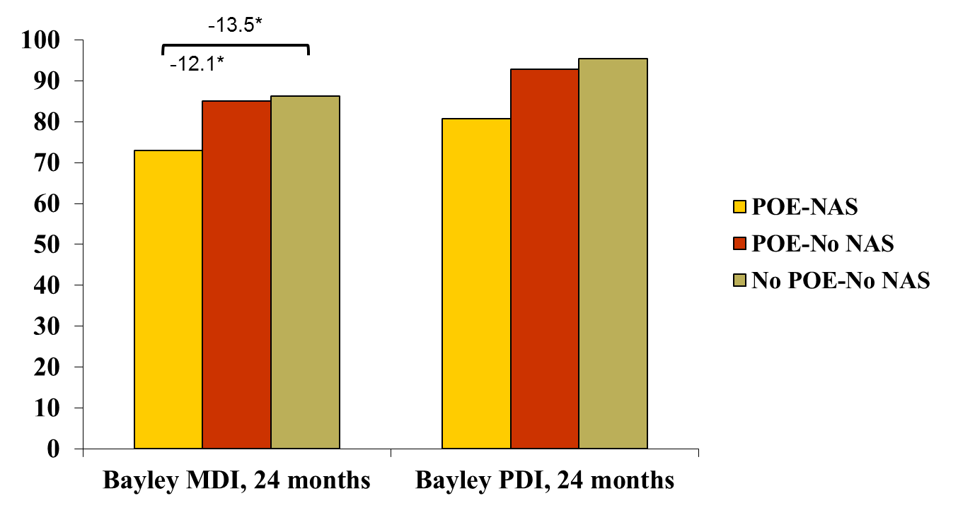
Maternal Lifestyle Study- NAS
-14.6*
-12.2*
*Mean difference between groups, Bonferroni correction
(Camardo 2019)

Slide 19
Opioids and Developmental Outcome
Another limitation is related to the assessment of NOWS.
However, in the vast majority of research, how a NOWS diagnosis may impact neurodevelopmental outcome among children who were exposed to opioids prenatally was not examined.
lack of consensus about the method used to assess and diagnose NOWS
lack of widespread use of a neurodevelopmental risk- monitoring marker at birth that can be used to identify newborns at risk for NOWS and track their long-term neurodevelopmental outcomes.

Slide 20
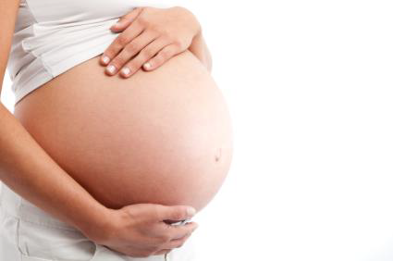
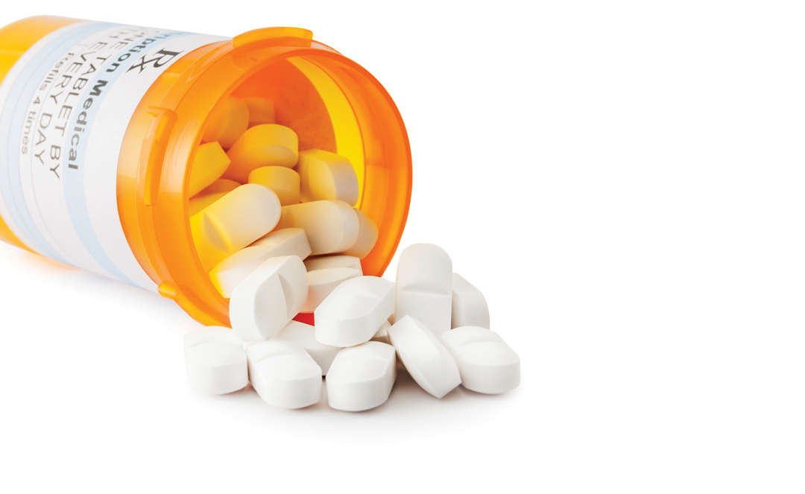
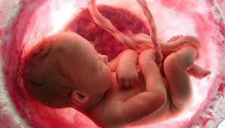
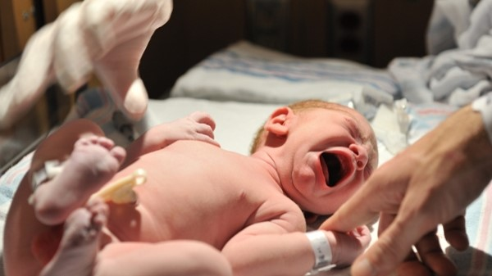

NOT EVERY OPIOID EXPOSED BABY
DEVELOPS NAS/NOWS!!!
60% - 70%
30% - 40%
Notes:
MC

Slide 21
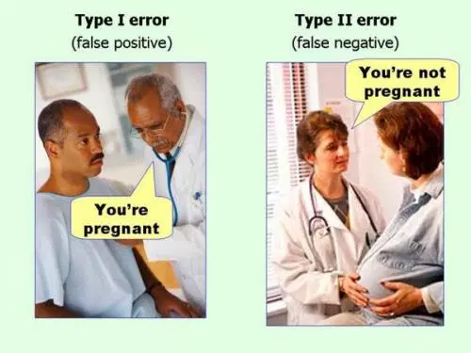
Accurate Diagnosis of NAS is Critical

Slide 22
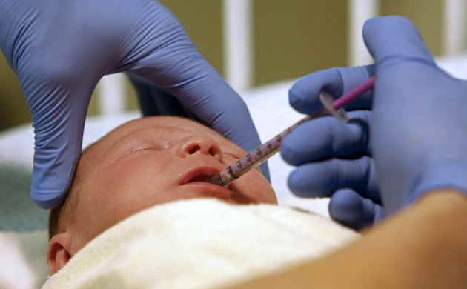
Pharmacological Treatment of NAS
Methadone?
Morphine?

Slide 23
How Do You Diagnose NAS?

Slide 24

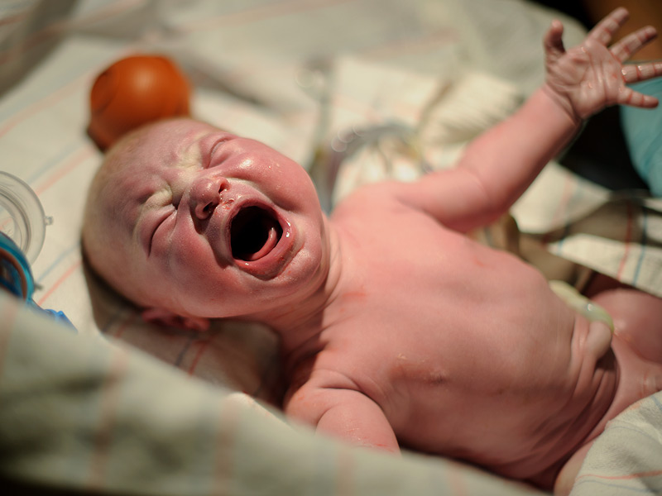
Definition of High Pitched Cry is VERY Subjective
Crying Excessive/Continuous High Pitch:
“when the infant is unable to decrease crying within a 15 second period…or if the infant continues to cry intently or continuously for up to 5 minutes…if these signs are present this item (excessive high-pitched cry) should be scored whether the infant’s cry is high pitched or not”

Slide 25
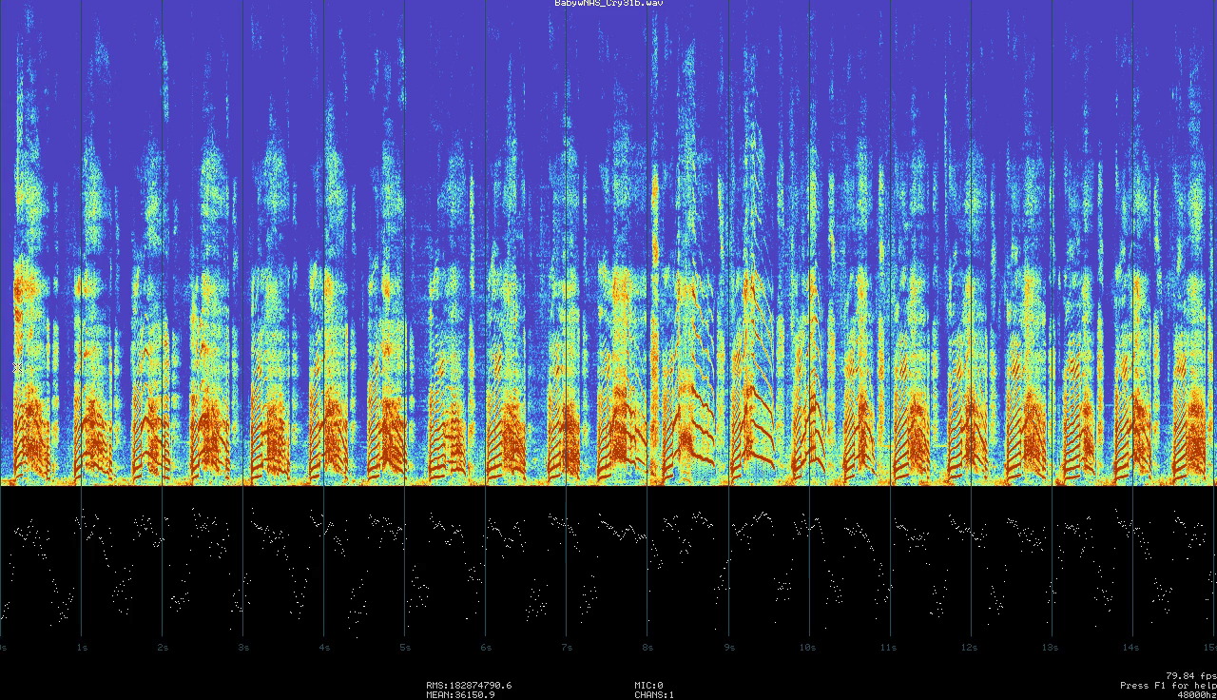
Start Drug Treatment: Misdiagnosis?

Slide 26
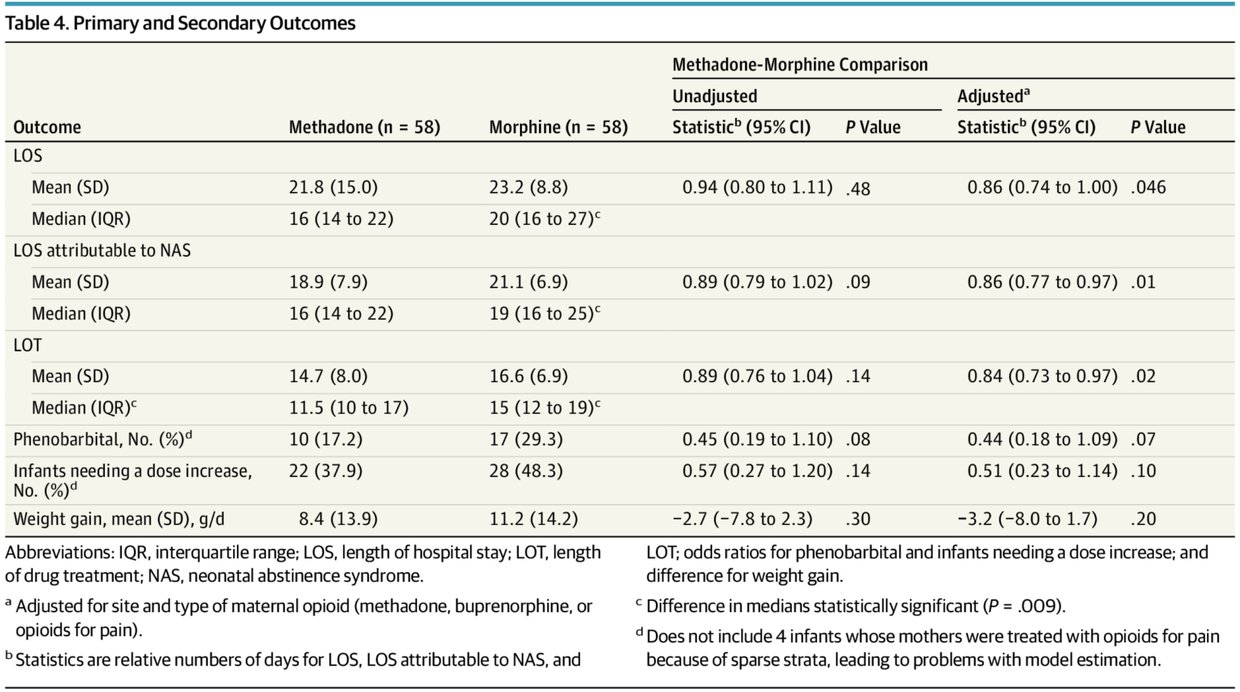
Methadone vs Morphine to Treat NAS
 |  |  | Methadone-Morphine Comparison
Outcome | Methadone (n= 58) | Morphine (n=58) | Unadjusted | Adjusted*
LOS
Mean (SD) | 21.8 (15.0) | 23.2 (8.8) | CI: 0.94 (0.80 – 1.11) p= 0.48 | CI: 0.86 (0.74 – 1.00) p= 0.046
Median (IQR) | 16 (14 to 22) | 20 ( 16 to 27)
LOT
Mean (SD) | 14.7 (8.0) | 16.6 (6.9) | CI: 0.89 ( 0.76 – 1.04) p= 0.14 | CI: 0.84 (0.73 – 0.97) p= 0.02
Median (IQR) | 11.5 (10 – 17) | 15 (12 -19)
*Adjusted for site and type of maternal opioid (methadone, buprenorphine, or opioids for pain)
(Davis et al., 2018)
Notes:
Create a table From scratch

Slide 27
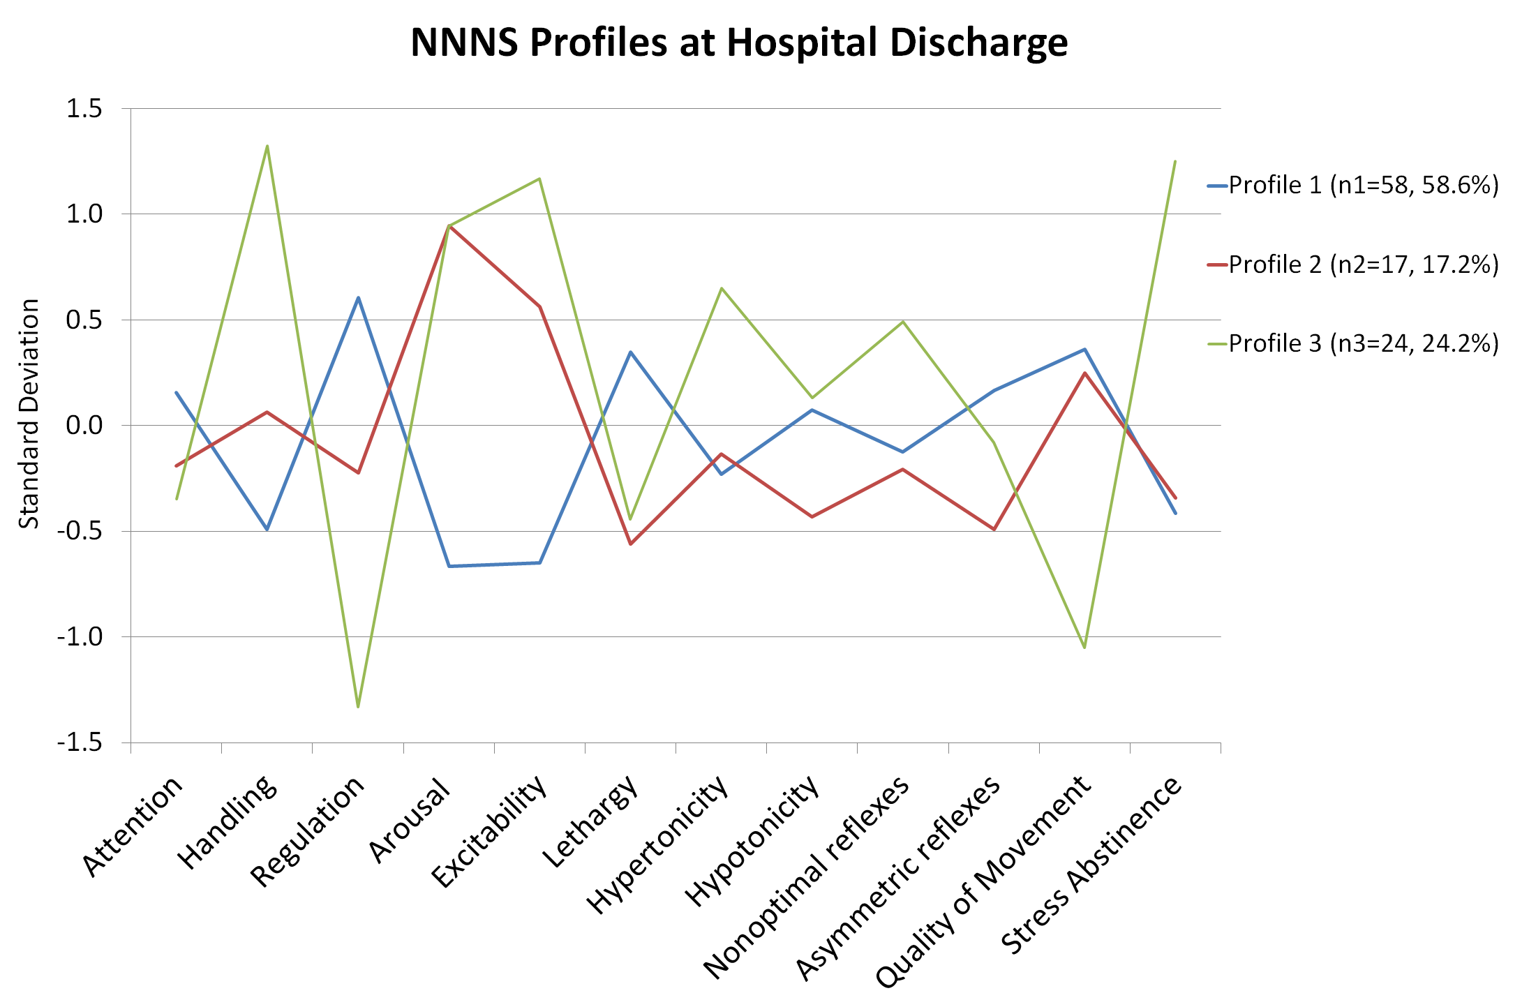
Treatment Medication and Neurobehavior
Notes:
Latent profile analysis was used to group infants into 3 mutually exclusive categories using 12 NNNS summary scores.
Membership for categorical latent profiles that represent heterogeneous subgroups was inferred from the 12 NNNS variables. LPA models with different numbers of profiles were fitted. Determination of the best model fit was assessed via Bayesian information criteria (BIC) adjusted for sample size, whereby the smallest BIC value indicates the best fit as well as minimization of cross classification probabilities.
Profile validated in previous studies by Lester

Slide 28
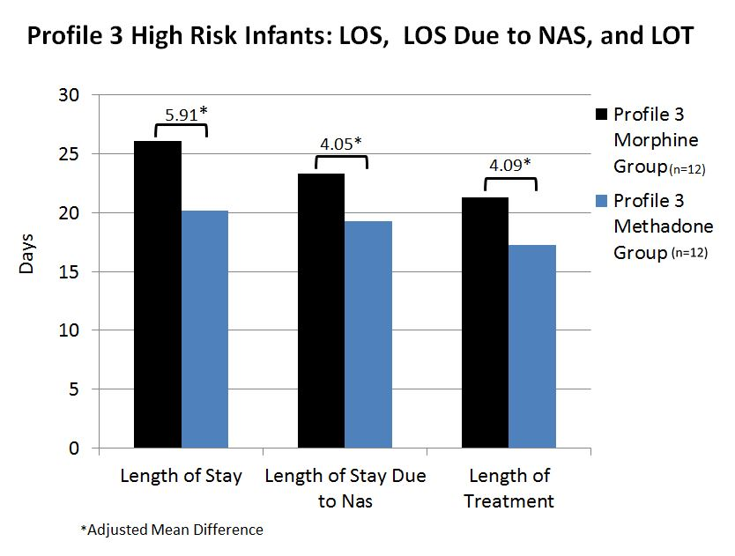
Treatment Medication and Neurobehavior

Slide 29
(Czynski et al, in press)

Slide 30
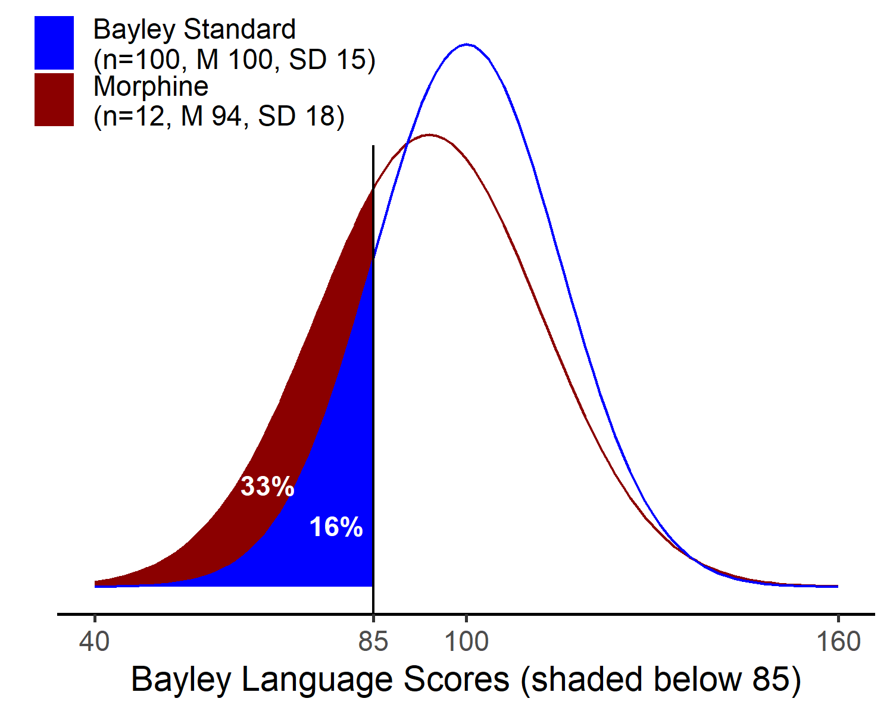
Language Composite Score:
Morphine Treated vs Normative Sample
Chi Square = 4.81, P= .03
30%
30%
16%
(Czynski et al, in press)
Notes:
This slide compares Language Composite scores for morphine treated infants to a Bayley Normative Sample
The Bayley-III normative sample has a mean 100 with a standard deviation of 15 points. Approximately 16% of the normative sample will fall below 1 standard deviation.
For the morphine treated infants approximately 33% (12 total) scored <85 or 1SD on the Bayley Language Composite.
The 33% proportion of infants with scores < 85 on the Language Composite in the morphine group is higher than the 16% in the Bayley-III normative sample (n=100), Chi Square = 4.81, P= .03.

Slide 31
A Solution-Oriented Research Agenda
Large, representative, prospective studies that account for confounding variables with long term outcomes.
Large prospective studies that account for confounding variables to improve the assessment, diagnosis and management of NOWS.
Include a short-term neurodevelopmental outcome as a marker of risk for neurodevelopmental impairment in infancy, toddlerhood, or childhood.
Examine not only neurodevelopment, NOWS, and length-of-stay as outcomes but also length of treatment, length of treatment due to NOWS, and newborn neurobehavior – A NOWS Severity Index

Slide 32
A Solution-Oriented Research Agenda
Outcomes should be assessed beyond early childhood, given that some effects of prenatal opioid exposure may be latent, and not emerge until adolescence when children’s cognitive and executive functioning skills may be challenged in school settings.
Incorporate maternal reports of substance and psychopharmacology use, ideally beginning prenatally, as well as collection of biospecimens so that toxicology screens can be performed on (1) maternal hair, (2) cord blood, and/or (3) meconium.

Slide 33
A Solution-Oriented Research Agenda
In addition to studying adverse outcomes (e.g. low IQ) also study adaptive outcomes and protective and resilience factors are also needed to inform preventive intervention.
Biomarkers: genetic, epigenetic, neuroendocrine (cortisol), autonomic (heart rate variability).
Biomarkers to predict which infants will develop NOWS with treatment implications.
Study of non-pharmacological treatment (Rooming-in, breastfeeding, kangaroo care, and swaddling).

Slide 34
NOWS Research at Women and Infants
Pragmatic, randomized, blinded trial to shorten pharmacologic treatment of newborns with neonatal opioid withdrawal syndrome (NOWS)(A. Laptook).
Prospective randomized blinded trial to shorten pharmacologic treatment of newborns with neonatal opioid withdrawal syndrome (NOWS)(A. Czynski).
Monitoring newborn sleep to improve treatment and outcomes from opioid exposure (A. Salisbury).
Clinical markers of neonatal opioid withdrawal syndrome: onset, severity and longitudinal neurodevelopmental outcome (B. Lester).
Improving the diagnosis of NAS (B. Lester).
Funding: NIH (COBRE on Opioids and Overdose, ECHO ACT NOWS, NIDA), Brown University Biomedical Innovations

Slide 35
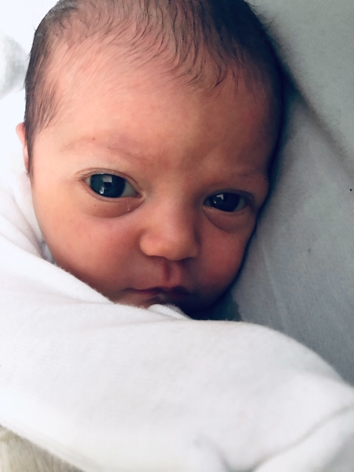
Meet Paloma

